Slide 1


University Of Puthisastra
WEB FINAL PRESENTATION
Restaurant Management
Group Member
Oum Somnang (Leader)
Norn Sokkun
Doung Dara
Neang Sovanthai
Roeuy Kay
Chhay Lang
Lecturer : Lypengleang Seang
Subject : Web Application
Semester II, Year 3

Slide 2
Agenda
Introduction
Problem & Solution
Project development and prototype
Project Feature
What we haven’t done?
What we have done?
Suggestion
Conclusion

Slide 3
Introduction
A restaurant management system is a type of point-of-sale (POS) software specifically designed for restaurants, bars, food trucks and others in the food service industry. Unlike a POS system, RMS encompasses all back-end needs, such as inventory and staff management.

Slide 4
Problem
Customer difficult to find good restaurant or type of food that they need
Some time get not standard food
Spend a lot of time to find food eat they need
Food Security Issues and Challenges.
Costs and Budget Management.
Staff and Customer Service.

Slide 5
Solution
Effectively manage stock/inventory, modify menu items/prices as well as discounts
Easily handle their daily business activities like reservation management along with guest reservation
Prevents wastage, both in terms of food and money and helps to maximize your budget
Efficient management
Increased productivity
Improved supply chain management

Slide 6



Project development and prototype
Programming Language : Laravel
IDE : VScode
SQL Database : MySQL

Slide 7
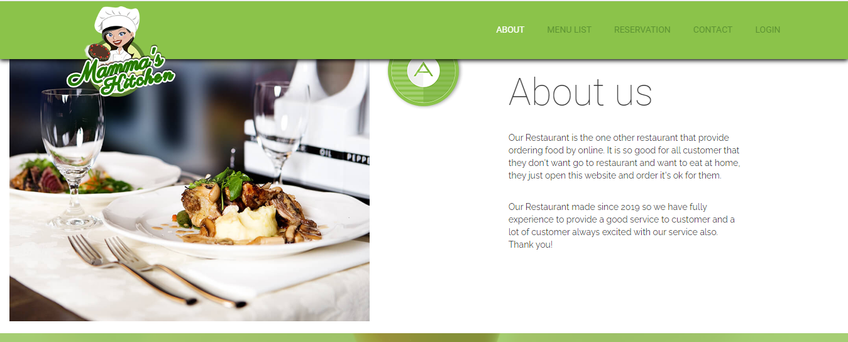
Feature
Front end
About us page

Slide 8
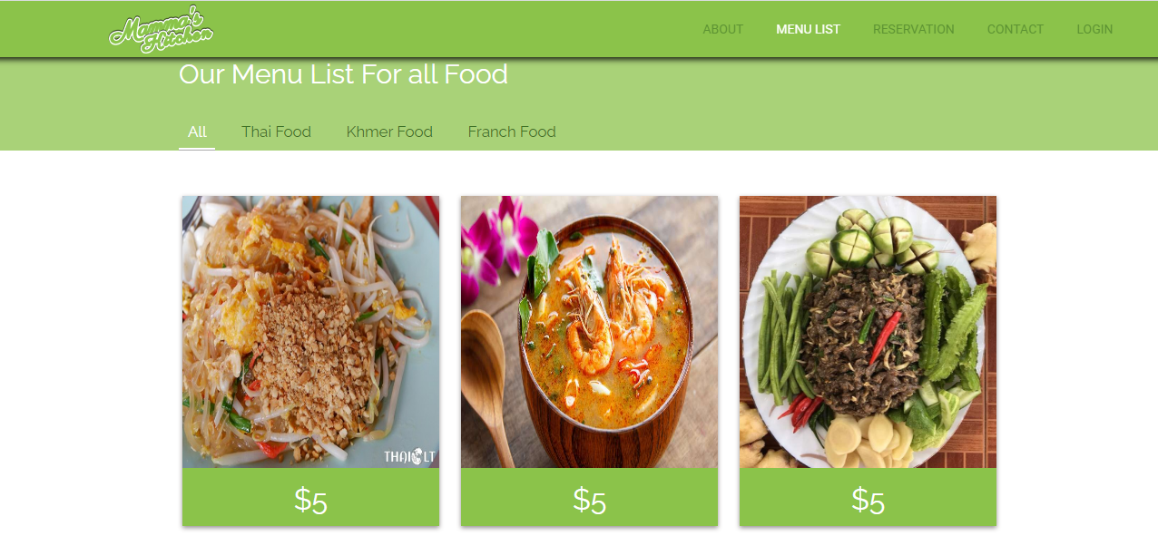
Feature
Front end
Menu List page

Slide 9
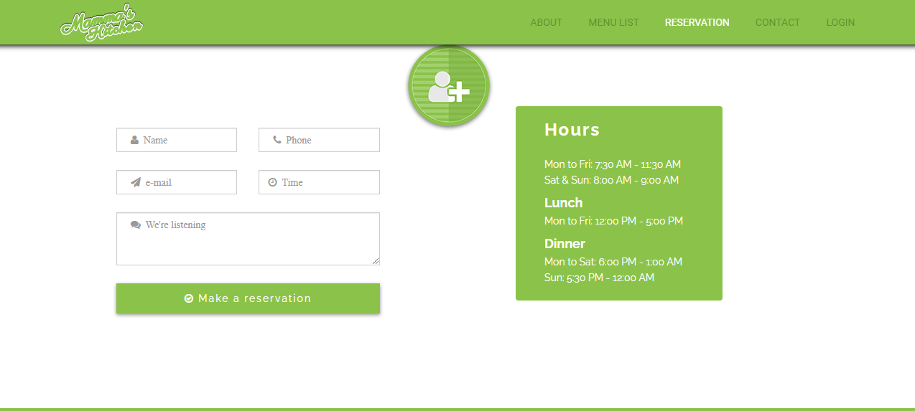
Feature
Front end
Reservation Page

Slide 10
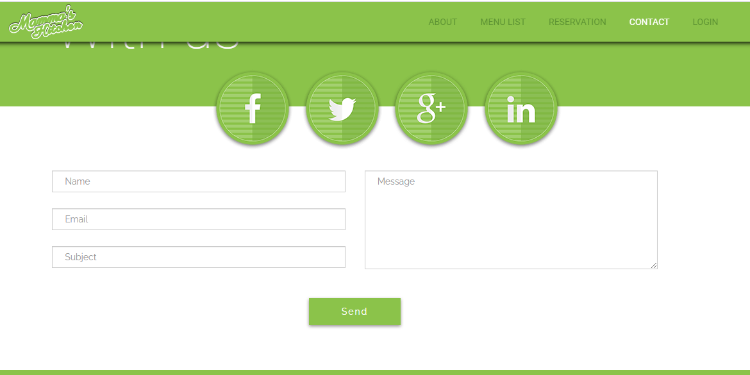
Feature
Front end
Contact Page

Slide 11
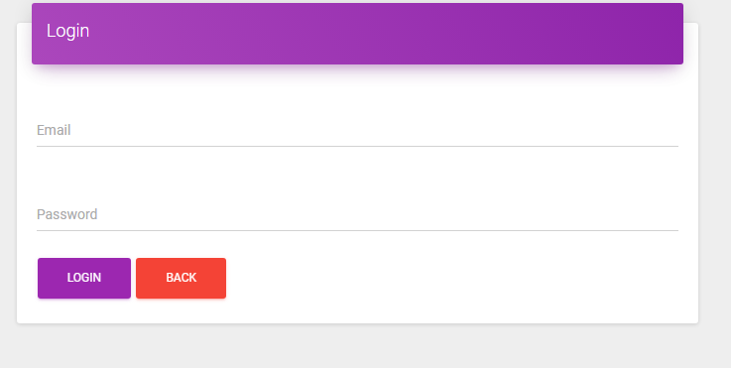
Feature
Front end
Login Page

Slide 12
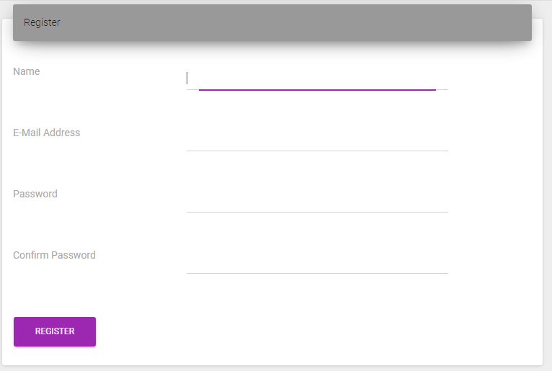
Feature
Front end
Register Page

Slide 13
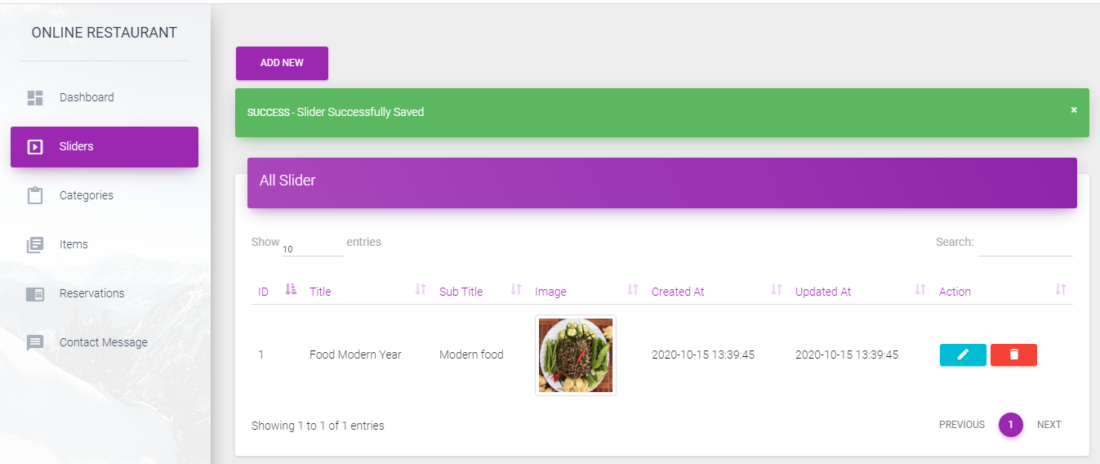
Feature
Backend
Slider

Slide 14
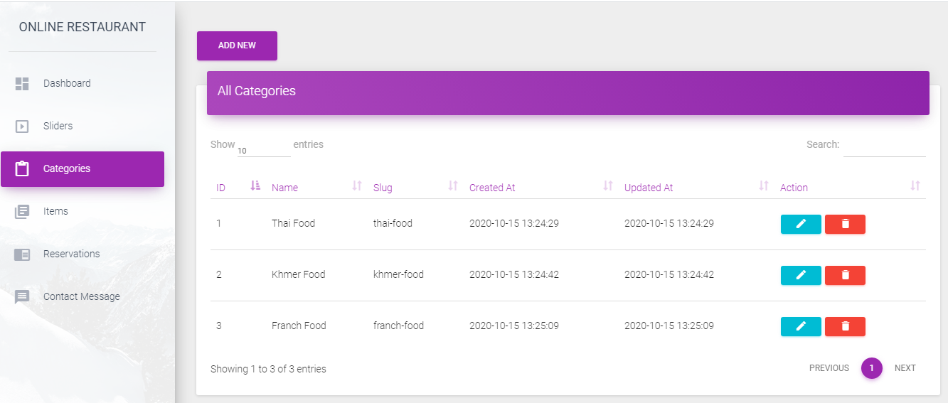
Feature
Backend
Category

Slide 15
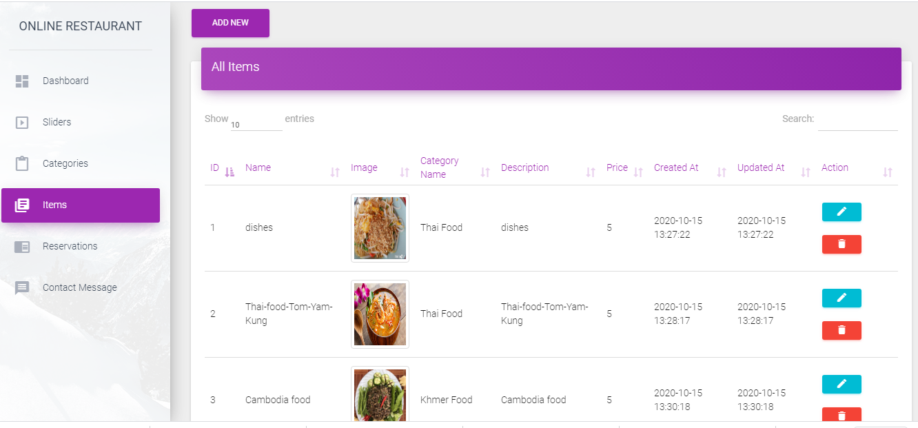
Feature
Backend
Item

Slide 16
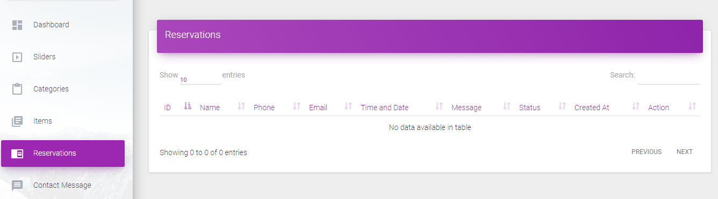
Feature
Backend
Reservation

Slide 17
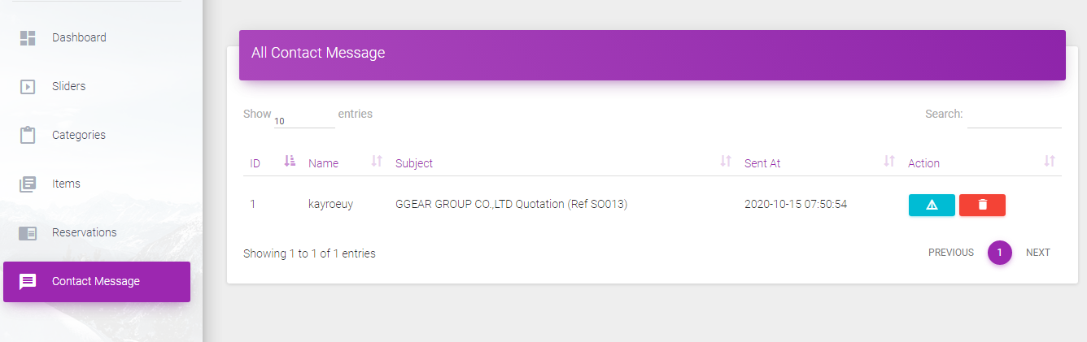
Feature
Backend
Contact

Slide 18
What we have done?
Login
Register
Category
Reassertions
Contact Us

Slide 19
What we haven't done?
Sent Mail
Forget Password
Role Management

Slide 20
Suggestion
Add more session about sent mail
Push notification
Upload image

Slide 21
Conclusion
The project entitled Restaurant Management System has been proposed to be implementing to replace the manual system.
The success of every major restaurant business chain lies in its operations and management. These tools will provide you with an opportunity to make your restaurant and life much easier. Not only will they help your restaurant expand, but will also make it more efficient at a lower cos

Slide 22
Demo

Slide 23


Slide 24


